Slide 1
TERMS AND CONDITIONS
These PowerPoint slides are a tool for lecturers, and as such:
YOU MAY add content to the slides, delete content from the slides, print out the slides, and save the slides onto your computer or server.
YOU MAY NOT resell, reproduce or redistribute the content in any form whatsoever, without prior written permission from the copyright holder.
© Troupant Publishers (Pty) Ltd, 2016
Selected images used under licence from Shutterstock.com

Slide 2
Engineering Systems
NQF Level 2

Slide 3
Setting up and operating equipment with simple control systems
Module 13

Slide 4
Planning
Unit 13 .1

Slide 5
Defining planning
A plan and is concerned with the following questions:
What must be done?
Where must it be done?
By when must it be done?
How must it be done?

Slide 6
Reasons for planning
The six main reasons for planning are to:
Provide direction with regard to what goals must be achieved.
Decide which tasks must be done to achieve these goals.
Identify and commit resources to achieve the goals.
Set standards to facilitate control.
Avoid mistakes.
Minimise waste.

Slide 7
Completing a task in accordance with the manufacturer’s recommendations
Things to consider:
Take note of the description of the machine.
Collect data from the manufacturer’s manual for the machine.
Obtain records of the past performance of the machine.
Obtain the necessary plans, drawings and diagrams.

Slide 8
Completing a task in accordance with the manufacturer’s recommendations
When must the task start?
By what date and time must the task be completed?
How many workers are required to complete the task?
What tools and equipment do you need?
What PPE is required?

Slide 9
Completing a task in accordance with the manufacturer’s recommendations
What materials must be ordered?
What documentation is needed according to the job instructions?
Inform all the relevant parties who will be affected.
What will happen in the case of unforeseen circumstances, such as strikes or unavailability of materials?

Slide 10
Drafting a detailed plan
Unit 13 .2

Slide 11
Data on a machine or equipment
Data or information about a machine is necessary for effectively setting up and operating it.
Build up information from:
Specifications and information in manufacturer’s manual.
Job cards.
Manufacturer’s manual and history of the equipment on computer.

Slide 12
Preparing a plan for the repair of a drill press
Figure 13.2 A drill press

Slide 13
Specifications of a drill press
Size of the drilling machine table.
Largest bit the machine can hold.
Maximum size of the hole that can be drilled.
Maximum size of the workpiece that can be held.
Power of the motor.
Spindle speed.

Slide 14
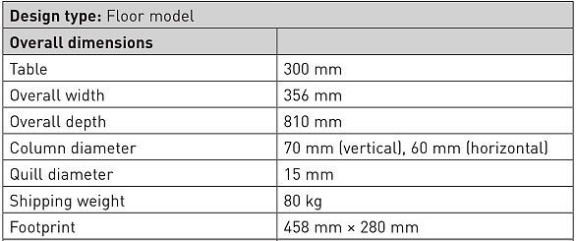
Specifications of a drill press
Table 13.1 Specifications for a drill press

Slide 15
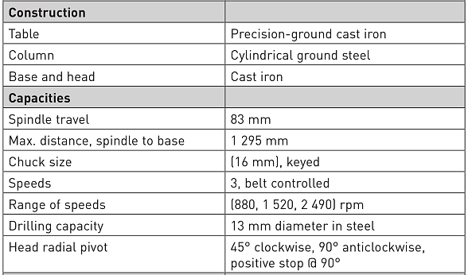
Specifications of a drill press
Table 13.1 Specifications for a drill press (continued)

Slide 16
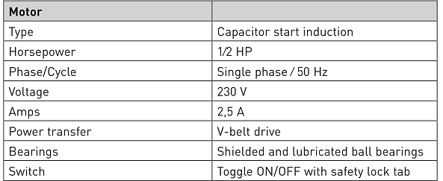
Specifications of a drill press
Table 13.1 Specifications for a drill press (continued)

Slide 17
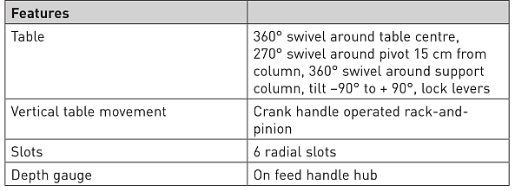
Specifications of a drill press
Table 13.1 Specifications for a drill press (continued)

Slide 18
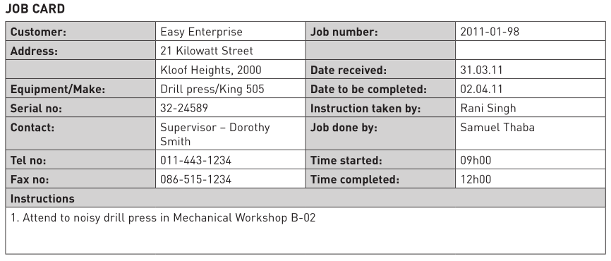
Obtaining records on the drill press
Figure 13.4 Example of a job card

Slide 19
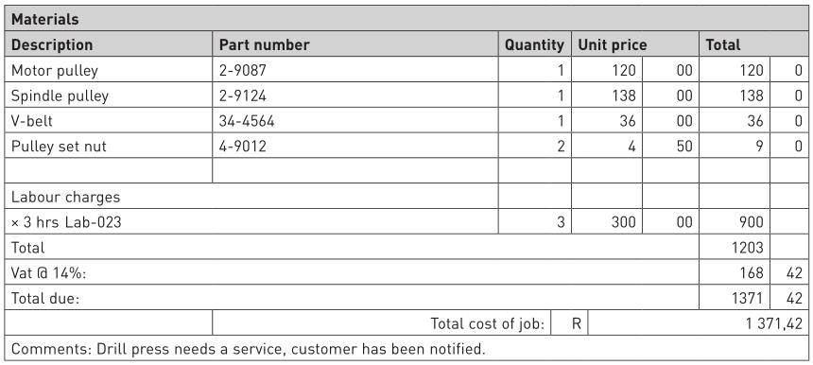
Obtaining records on the drill press
Figure 13.4 Example of a job card (continued)

Slide 20
VIDEO: Mabena starting work

Slide 21
Isolating the machine
Unit 13 .3

Slide 22
The lock-out and tag-out (LOTO) procedure
Reasons for the LOTO procedure:
Electrocution as a result of contact with live circuits.
Cuts, bruises, crushing, amputation or death resulting from entanglement with belts, chains, conveyors, rollers, shafts or impellers.
Burns resulting from contact with hot parts, materials or equipment such as furnaces.
Fires and explosions.
Chemical exposure to gases or liquids released from pipelines.

Slide 23
The lock-out and tag-out (LOTO) procedure
Performing the LOTO procedure:
There are two parts to the procedure:
Application of control.
Release from control.

Slide 24
Performing the LOTO procedure
Application of control
Notify all affected employees that maintenance or repair work is required on a machine and that the machine must be shut down and locked out.
Identify the types and magnitude of the energy that the machine uses and the methods necessary to control the energy.

Slide 25
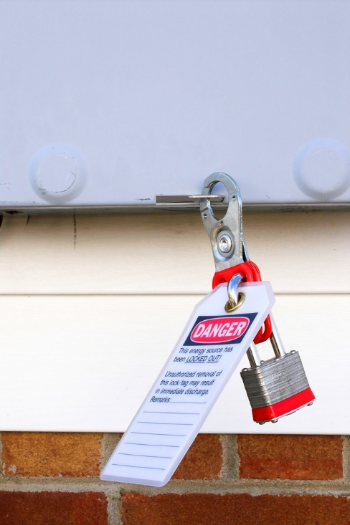
Performing the LOTO procedure
Application of control
Shut down the machine.
De-activate the energy-isolating device so that the machine is isolated from the energy source.
Attach a lock and tag on the energy-isolating device.
Release stored or residual energy.
Figure 13.7 Attaching a lock and tag

Slide 26
Performing the LOTO procedure
Application of control
Verify that the machine has been disconnected from the energy source:
First check that no personnel are exposed.
Then check the isolation of the machine by engaging the normal operating controls or by testing to make certain the machine will not operate.
Finally, return the operating controls to the neutral or off position.
The machine is now locked out.

Slide 27
Performing the LOTO procedure
Release from control
Check the machine and the immediate area to ensure that non-essential items have been removed and that safeguards are operationally intact.
Check the work area to ensure that all employees have been safely positioned or removed from the area.
Verify that the controls are in the off or neutral position.

Slide 28
Performing the LOTO procedure
Release from control
Remove the lock-out and tag-out devices and re-energise the machine.
Notify affected employees that the maintenance or repair work has been completed and the machine is ready for use.

Slide 29
Multiple lock-out and tag-out (LOTO) procedure
Each person working on the machine must place a lock and tag on the energy-isolating device.
As each employee involved no longer needs to maintain LOTO protection, that employee removes his or her lock and tag.

Slide 30
Adjusting settings and monitoring equipment
Unit 13 .4

Slide 31
Adjusting the settings on a drill press
Speed change
Loosen the belt tension lock knob on the side of the headstock.
Pivot the motor to take tension off the V-belt.
Determine the desired speed on the chart and move the V-belt to the desired V-grooves on the motor spindle pulleys.
Pivot the motor towards the back of the headstock.
Tighten the lock knob once the desired V-belt tension is achieved.
Close the cover.

Slide 32
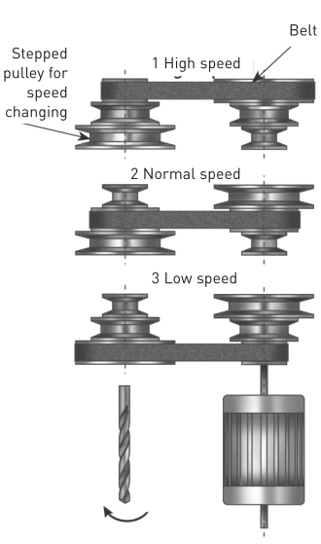
Adjusting the settings on a drill press
Speed change
Figure 13.8 Adjusting speed

Slide 33
Adjusting the settings on a drill press
Depth stop
Loosen the depth collar lock knob.
Secure the wood stock you will be drilling onto the drill press table.
With the correct drill bit installed, lower the spindle until the tip of the bit just touches the wood stock. Hold the spindle in this position.

Slide 34
Adjusting the settings on a drill press
Depth stop
Turn the depth collar to the desired depth indicated by the scale on the collar.
Secure the collar by tightening the lock knob.
Remove the wood stock and test the depth stop by measuring how far the spindle travels when the handles are rotated.

Slide 35
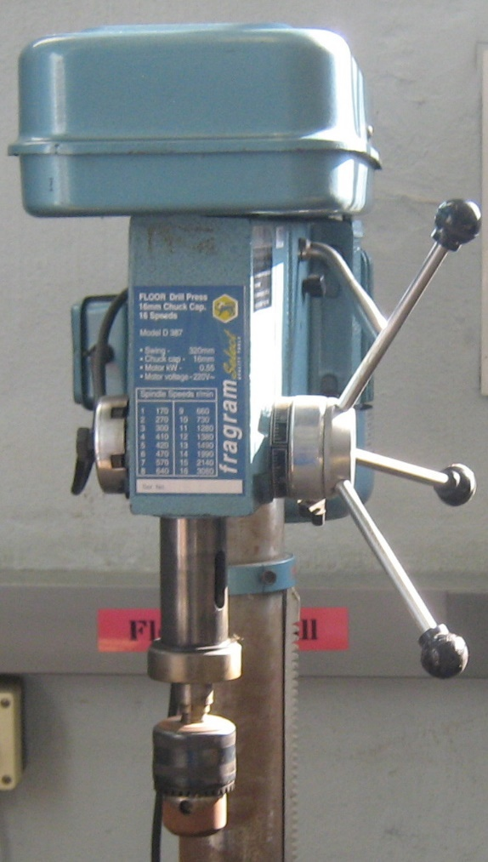
Adjusting the settings on a drill press
Depth stop
Figure 13.9 Loosening the collar lock knock

Slide 36
Adjusting the settings on a drill press
Table adjustments
Loosen the table support bracket lock handle.
Turn the table hand crank to lift or lower the table.
Remember to lock the support bracket in place before operating the machine.

Slide 37
Adjusting the settings on a drill press
Head adjustments
The headstock can be tilted from 45° clockwise to 90° anticlockwise:
Loosen the lock handle on the right side of the headstock.
Pull out the guide pin located on the left side of the headstock and rotate the pin 90°.
Tilt the headstock to the desired angle specified on the scale and tighten the lock handle on the right side of the headstock.

Slide 38
Adjusting the settings on a drill press
Head adjustments
To return the headstock to a vertical position:
Loosen the lock handle located on the right side of the headstock.
Move the headstock to its original position and move the guide pin back into the guide slot.
Tighten the lock handle before operating the machine.

Slide 39
Monitoring equipment and making adjustments while in operation
Starting and monitoring a drill press
Remove the lock-out and tag-out devices.
Turn on the power supply at the main panel.
Press the start button. Make sure that your finger is poised on the stop button, just in case there is a problem.
The drill press should run smoothly, with little or no vibration or rubbing noises.
Investigate and correct strange or unnatural noises before operating the machine further.

Slide 40
Monitoring equipment and making adjustments while in operation
Making adjustments – changing the drill bit
Disconnect the machine from the power source and perform the LOTO procedure.
Open the chuck wide enough to accept a new bit.
Install the bit so the chuck jaws will grab as much of the bit shank as possible.
Tighten the chuck with the chuck key using any of the three key end locations. This does not apply if a keyless chuck has been installed.

Slide 41
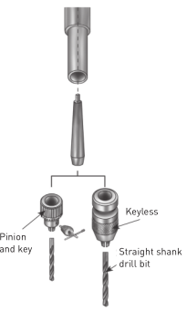
Monitoring equipment and making adjustments while in operation
Making adjustments – changing the drill bit
Figure 13.10 Types of chucks

Slide 42
Monitoring equipment and making adjustments while in operation
Making adjustments – changing the drill bit
Remove the chuck key and reconnect the power source.
Reverse steps to remove the drill bit.
If taper sockets are used, use a drift to remove the drills and sockets from the drill press spindle.

Slide 43
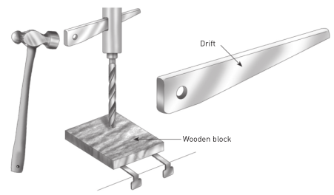
Monitoring equipment and making adjustments while in operation
Making adjustments – changing the drill bit
Figure 13.11 Using a drift to remove drills and sockets

Slide 44
Monitoring equipment and making adjustments while in operation
Making adjustments – changing the drill bit
Check for the following conditions and repair or replace when necessary:
Loose mounting bolts.
Worn switch.
Worn or damaged cords and plugs.
Damaged V-belt.
Any other condition that could hamper the safe operation of the machine.

Slide 45
Summative assessment
Test your knowledge of this section by completing the Summative assessment (page 221 of your Student’s Book)

